Slide 1
great outdoors Group-b
By
Prafull Sharma
C Akhil Chowdary
Arshpreet
Abhishek
Ayush Agarwal
Sravani

Slide 2
EPIC AND USER STORY
EPIC :
Admin able to see the annual, quarterly and monthly Report of Retailer depending upon choice and get alerts.
Update Bonus of Sales Person depending upon the report generated . How much he redirected offline to online sales.

Slide 3
USER STORIES
Adding Retailer / Deleting Retailor
Updating Retailor
Searing and getting Retailer By Retailer ID , Name
Generating Quarterly, Monthly and Yearly Report
Updating Bonus of the Sales Person by Referring his data

Slide 4
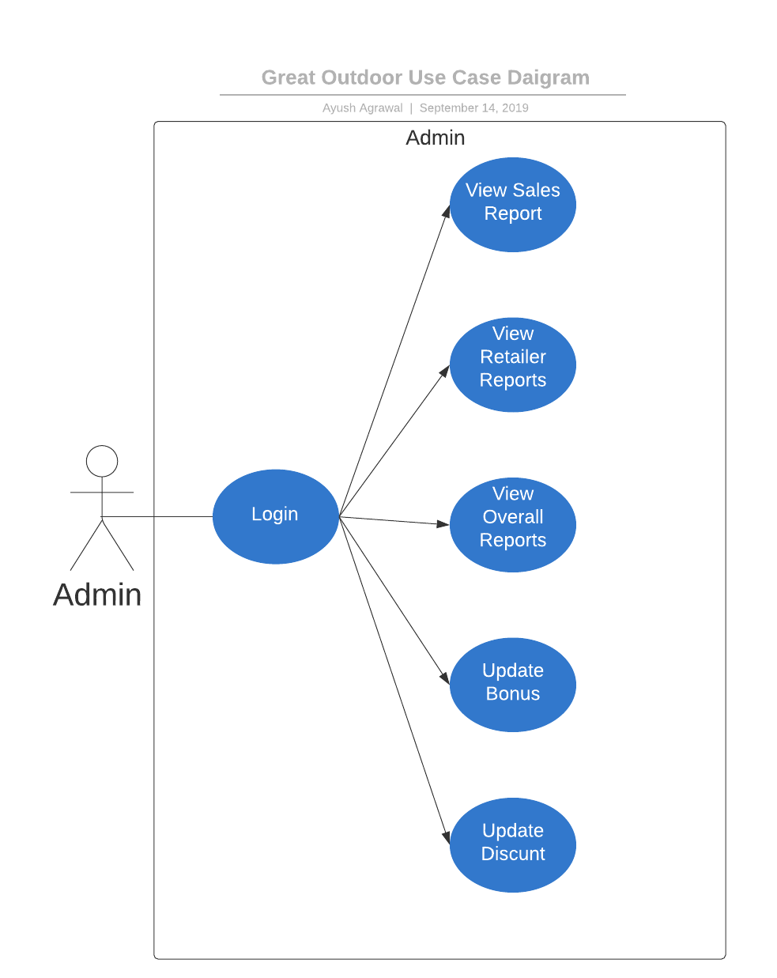
Use CASE DIAGRAM

Slide 5
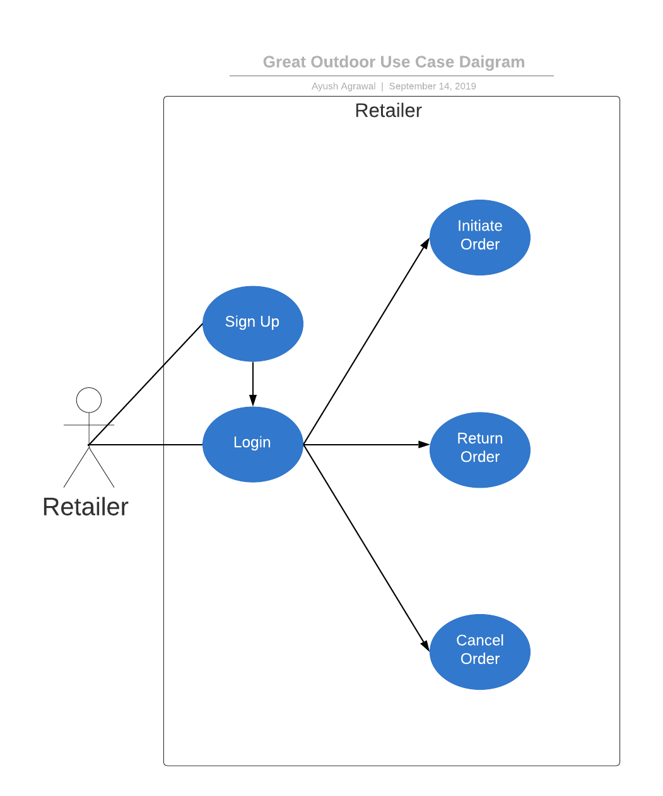

Slide 6
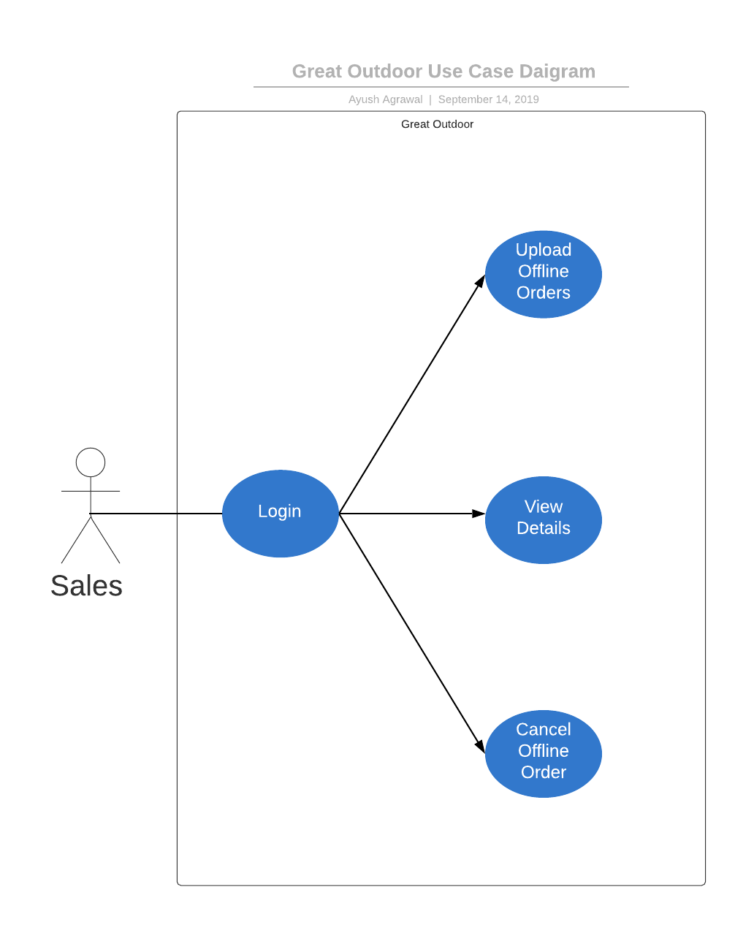

Slide 7
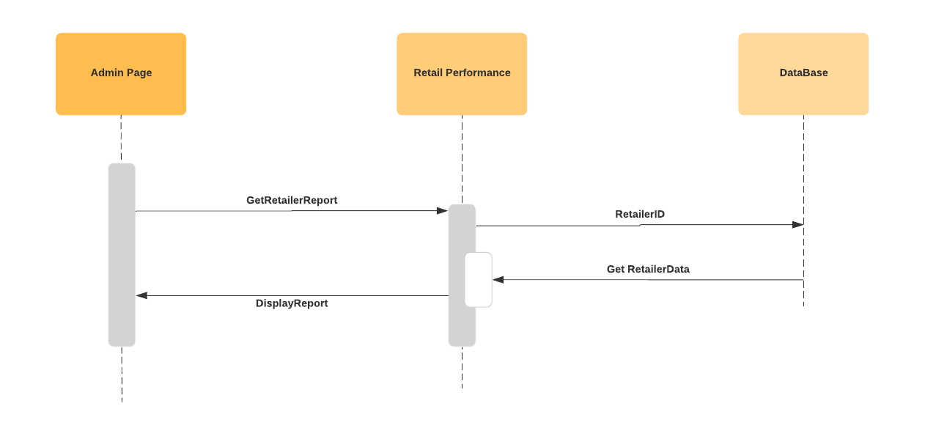
Sequence Diagram for Viewing Report

Slide 8
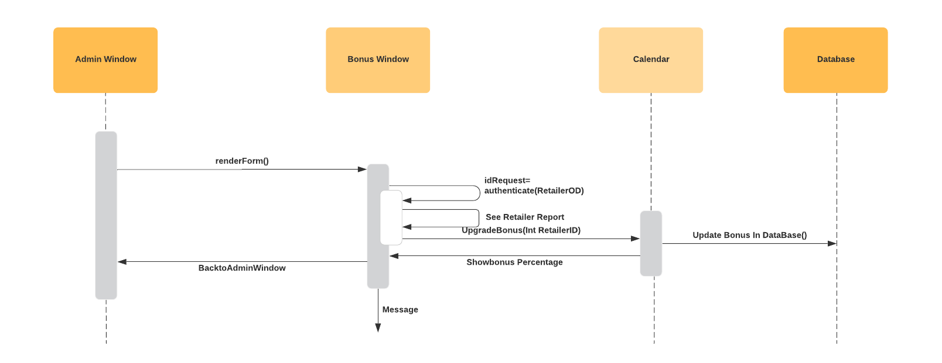
Sequence Diagram for UPDATING BONUS

Slide 9
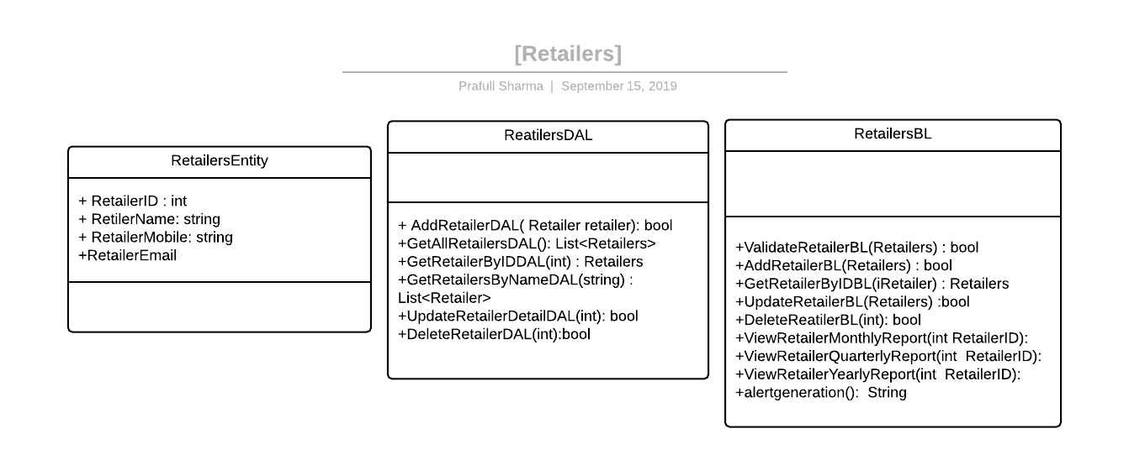
Class diagram

Slide 10
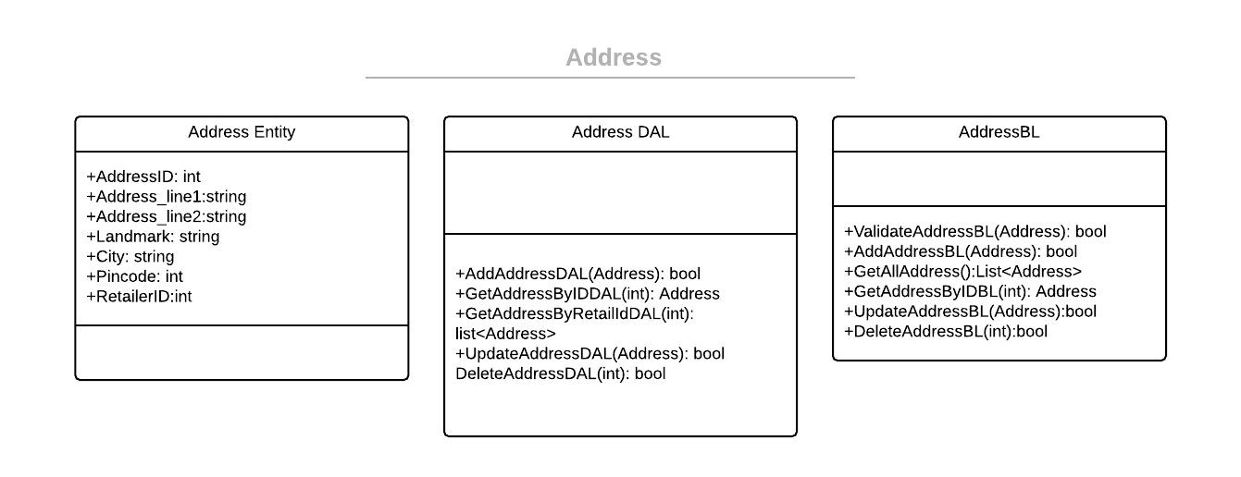
Class Diagram of Address Class

Slide 11
Thank you

